Slide 1





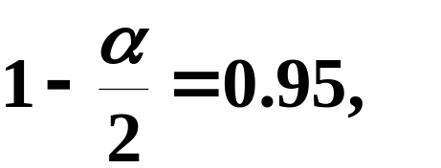



补充1
包糖机某日开工包了12包糖,
称得重量(单
位:克)分别为506,500,495,488,504,486,505, 513,521,
520,512,485.
假设重量服从正态分布,
解
附表1-1

Slide 2
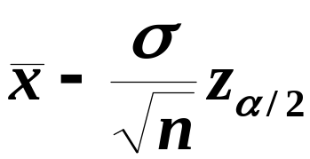
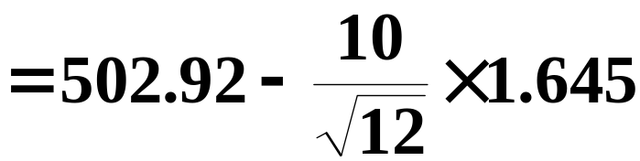

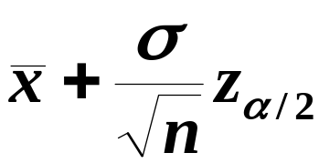
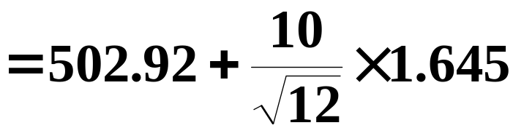


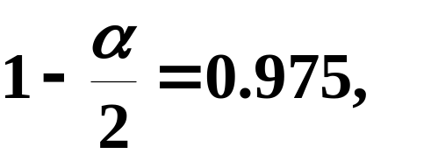


Slide 3





查表得
附表1-2

Slide 4






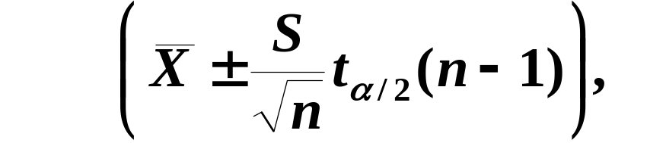

补充2
解

Slide 5
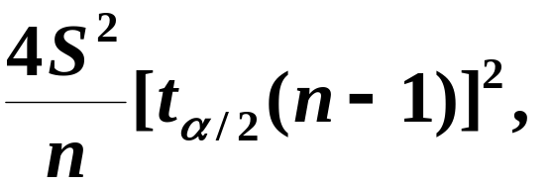


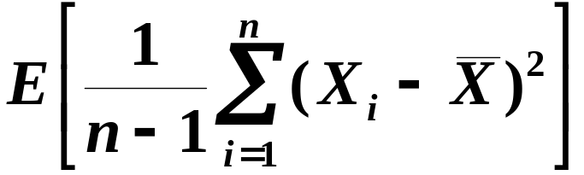

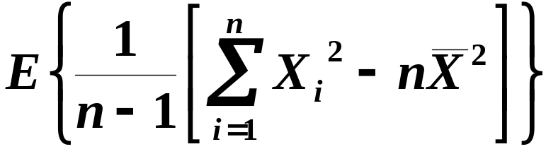
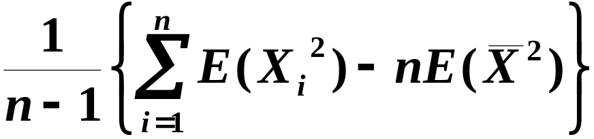

Slide 6
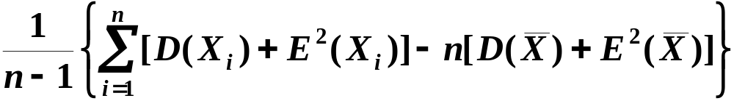
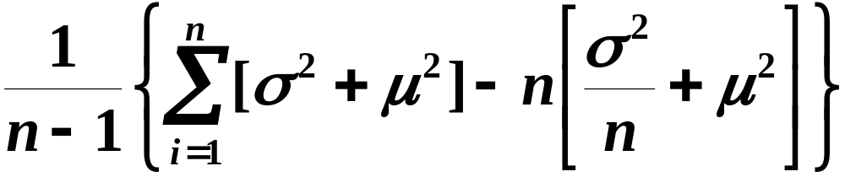

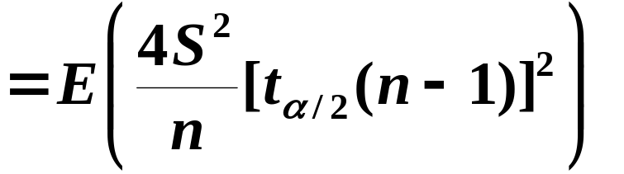

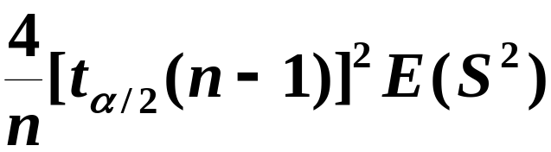
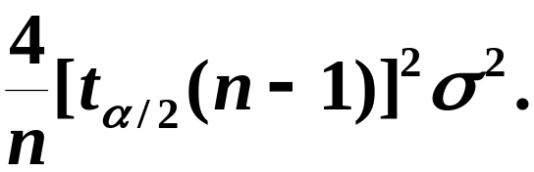

Slide 7
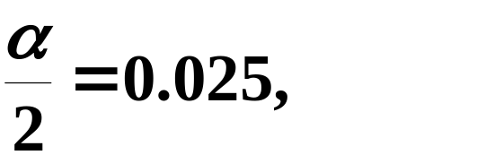
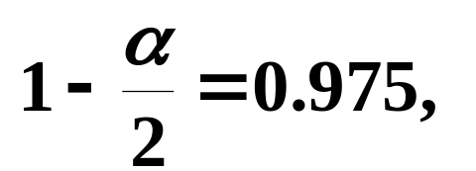


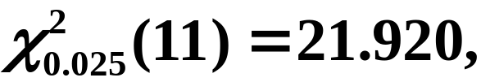
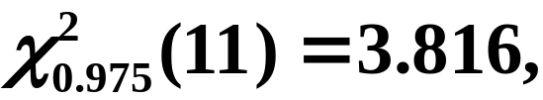




补充3
(续例1)
解

Slide 8
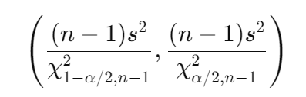

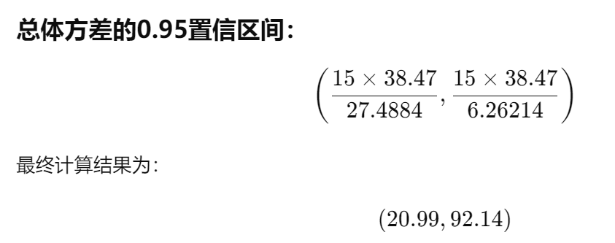


import numpy as np
import scipy.stats as stats
# 样本数据
data = np.array([506, 508, 499, 503, 504, 510, 497, 512, 514, 505, 493, 496, 506, 502, 509, 496])
# 样本大小
n = len(data)
# 样本均值
mean = np.mean(data)
# 样本方差
sample_variance = np.var(data, ddof=1)
# 卡方分布的临界值
alpha = 0.05
chi2_lower = stats.chi2.ppf(alpha / 2, n - 1)
chi2_upper = stats.chi2.ppf(1 - alpha / 2, n - 1)
# 总体方差的置信区间
variance_conf_interval = ((n - 1) * sample_variance / chi2_upper, (n - 1) * sample_variance / chi2_lower)
mean, sample_variance, variance_conf_interval

Slide 9
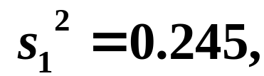
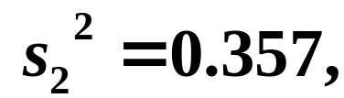








补充4
甲、乙两台机床加工同一种零件,
在机床甲
加工的零件中抽取9个样品,
在机床乙加工的零件
中抽取6个样品,
并分别测得它们的长度(单位:mm),
由所给数据算得
在置信度
0.98下,
试求这两台机床加工精度之比
的置
信区间.
假定测量值都服从正态分布,
方差分别为
解

Slide 10
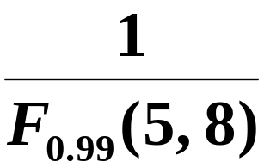
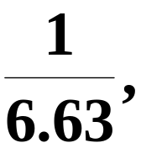



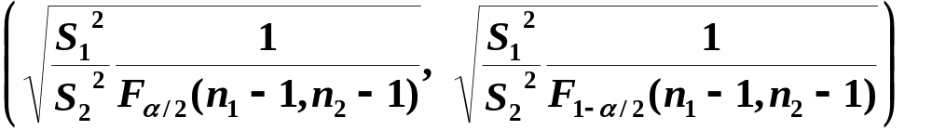
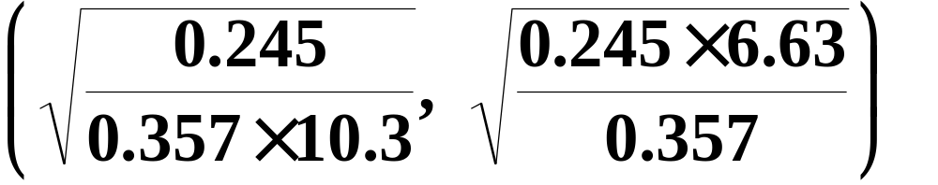


Slide 11
附表1-1
标准正态分布表
z | 0 | 1 | 2 | 3 | 4 | 5 | 6 | 7 | 8 | 9
0.0 0.1 0.2 0.3 0.4 0.5 0.6 0.7 0.8 0.9 1.0 1.1 1.2 1.3 1.4 1.5 1.6 | 0.5000 0.5398 0.5793 0.6179 0.6554 0.6915 0.7257 0.7580 0.7881 0.8159 0.8413 0.8643 0.8849 0.9032 0.9192 0.9332 0.9452 | 0.5040 0.5438 0.5832 0.6217 0.6591 0.6950 0.7291 0.7611 0.7910 0.8186 0.8438 0.8665 0.8869 0.9049 0.9207 0.9345 0.9463 | 0.5080 0.5478 0.5871 0.6255 0.6628 0.6985 0.7324 0.7642 0.7939 0.8212 0.8461 0.8686 0.8888 0.9066 0.9222 0.9357 0.9474 | 0.5120 0.5517 0.5910 0.6293 0.6664 0.7019 0.7357 0.7673 0.7967 0.8238 0.8485 0.8708 0.8907 0.9082 0.9236 0.9370 0.9484 | 0.5160 0.5557 0.5948 0.6331 0.6700 0.7054 0.7389 0.7703 0.7995 0.8264 0.8508 0.8729 0.8925 0.9099 0.9251 0.9382 0.9495 | 0.5199 0.5596 0.5987 0.6368 0.6736 0.7088 0.7422 0.7734 0.8023 0.8289 0.8531 0.8749 0.8944 0.9115 0.9265 0.9394 0.9505 | 0.5239 0.5636 0.6026 0.6406 0.6772 0.7123 0.7454 0.7764 0.8051 0.8315 0.8554 0.8770 0.8962 0.9131 0.9278 0.9406 0.9515 | 0.5279 0.5675 0.6064 0.6443 0.6808 0.7157 0.7486 0.7794 0.8078 0.8340 0.8577 0.8790 0.8980 0.9147 0.9292 0.9418 0.9525 | 0.5319 0.5714 0.6103 0.6480 0.6844 0.7190 0.7517 0.7823 0.8106 0.8365 0.8599 0.8810 0.8997 0.9162 0.9306 0.9430 0.9535 | 0.5359 0.5753 0.6141 0.6517 0.6879 0.7224 0.7549 0.7852 0.8133 0.8389 0.8621 0.8830 0.9015 0.9177 0.9319 0.9441 0.9545
1.645
返回

Slide 12
附表1-2
标准正态分布表
z | 0 | 1 | 2 | 3 | 4 | 5 | 6 | 7 | 8 | 9
1.6 1.7 1.8 1.9 2.0 2.1 2.2 2.3 2.4 2.5 2.6 2.7 2.8 2.9 3.0 | 0.9452 0.9554 0.9641 0.9713 0.9772 0.9821 0.9861 0.9893 0.9918 0.9938 0.9953 0.9965 0.9974 0.9981 0.9987 | 0.9463 0.9564 0.9648 0.9719 0.9778 0.9826 0.9864 0.9896 0.9920 0.9940 0.9955 0.9966 0.9975 0.9982 0.9990 | 0.9474 0.9573 0.9656 0.9726 0.9783 0.9830 0.9868 0.9898 0.9922 0.9941 0.9956 0.9967 0.9976 0.9982 0.9993 | 0.9484 0.9582 0.9664 0.9732 0.9788 0.9834 0.9871 0.9901 0.9925 0.9943 0.9957 0.9968 0.9977 0.9983 0.9995 | 0.9495 0.9591 0.9671 0.9738 0.9793 0.9838 0.9871 0.9904 0.9927 0.9945 0.9959 0.9969 0.9977 0.9984 0.9997 | 0.9505 0.9599 0.9678 0.9744 0.9798 0.9842 0.9878 0.9906 0.9929 0.9946 0.9960 0.9970 0.9978 0.9984 0.9698 | 0.9515 0.9608 0.9686 0.9750 0.9803 0.9846 0.9881 0.9909 0.9931 0.9948 0.9961 0.9971 0.9979 0.9985 0.9998 | 0.9525 0.9616 0.9693 0.9756 0.9808 0.9850 0.9884 0.9911 0.9932 0.9949 0.9962 0.9972 0.9979 0.9985 0.9999 | 0.9535 0.9625 0.9700 0.9762 0.9812 0.9854 0.9887 0.9913 0.9934 0.9951 0.9963 0.9973 0.9980 0.9986 0.9999 | 0.9545 0.9633 0.9706 0.9767 0.9817 0.9853 0.9890 0.9916 0.9936 0.9952 0.9964 0.9974 0.9981 0.9986 1.0000
1.96
返回

